Slide 1
UML Study Buddy App
Hussain Dar and Sridhar Rangan

Slide 2
Goal
UML Study Buddy App is designed to help students get to know other students in specific classes
This is so that these students can meet up to work together on homework, study for quizzes and exams, and do group projects together.
The app will be available for all students and will help introverted students and those who need help in their classes find additional help with peers.

Slide 3
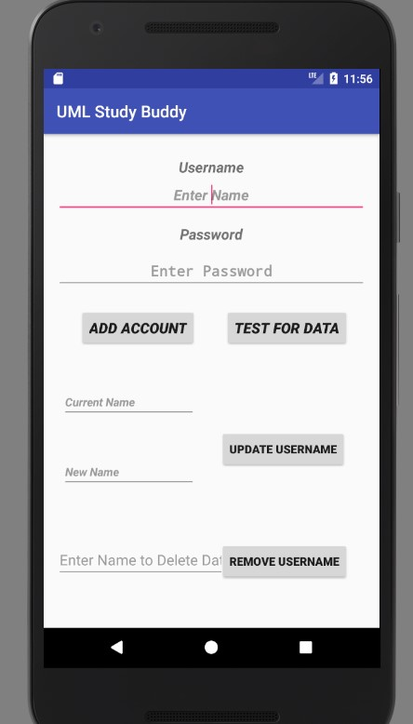

Slide 4
What has each person done
Hussain Dar:
Worked on the UI and working on adding classes
Sridhar Rangan:
Worked on DataBase for user accounts
Both teammates will work merging the portions together

Slide 5
Challenges
Managing two databases
One for accounts
One for class
Hopefully this will be figured out during the break!!

